Slide 1

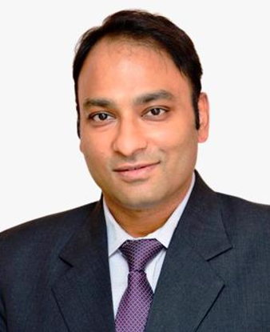

Slide 2
PROF. (DR) SONU GOEL
Qualifications & Experience
Prof. (Dr.) Sonu Goel obtained his MBBS and MD in Community Medicine from Indira Gandhi Medical College and Hospital and earned his Ph.D. from Maastricht University. He currently serves as Professor of Health Management at Post Graduate Institute of Medical Education and Research and has over 25 years of extensive experience in public health, health systems strengthening, health management, and tobacco control. He is also Adjunct Professor at the University of Limerick and has served as Honorary Professor at Swansea University.
About Me
Dr. SG
Prof. Dr. Sonu Goel is a renowned expert in Public Health with over 25 years of experience. He holds an MBBS and MD in Community Medicine from Indira Gandhi Medical College, Shimla, and a Ph.D. from Maastricht University, Netherlands. Prof. Goel has led over 50 national and international research projects and published more than 270 articles in top peer-reviewed journals. He has received numerous awards, including the Public Health Excellence of India in 2014. A leader in tobacco control, he chairs the MPOWER Research Group and is affiliated with prestigious institutions like PGIMER, Chandigarh, and the University of Limerick.
Research Projects & Publications
(Replace with photo)
Prof. Goel has successfully led and supervised more than 50 national and international research projects as Principal Investigator and Co-Investigator and is currently leading multiple ongoing projects in tobacco control, health systems, and implementation research. He has authored over 290 peer-reviewed scientific publications in reputed national and international journals and has contributed significantly to evidence generation in public health and tobacco control. His scholarly contributions also include edited books, policy documents, technical reports, and patents.
Education
2011 -
2020
PhD, Health System Research
Professor, Department of Community Medicine
& School of Public Health PGIMER Chandigarh
Director & President, Resource Centre for Tobacco Control (RCTC)
Lead, WHO Collaborative Centre for Research
& Training in Tobacco Control
Convenor, Scientific Support Group, MoHFW, GOI
Program Director, International Public Health Management Development Program (IPHMDP)
Adjunct Professor, University of Limerick, Ireland
Former Honorary Professor, Swansea University
University of Maastricht, Netherlands
2000 -
2003
MD, Community Medicine
Indira Gandhi Medical College, Shimla
Areas of Expertise
MBBS
🔹 Tobacco Control & WHO FCTC Implementation
🔹 Public Health & Health Systems Strengthening
🔹 Health Management & Policy Translation
🔹 Operational & Implementation Research
🔹 Capacity Building & Global Health Leadership
1993 -
1999
Indira Gandhi Medical College, Shimla
Awards & Achievements
Prof. Goel is a recipient of several prestigious national and international awards and fellowships, including the Dr. R.V. Rajam Recognition of Academic Excellence (RAE), Fellowship of the National Academy of Medical Sciences (FNAMS), Global Research Network Award by the Society for Research on Nicotine & Tobacco (SRNT), Dr. J.E. Park Oration Award, Harcharan Singh Oration Award, Vasudeva Oration Award, and Young Researcher Award by the IAPSM–FORD Foundation. He was also conferred with the Excellence in Public Health Award by the Hon’ble Union Minister of Health & Family Welfare, Government of India.
EMAIL
sonugoel007@yahoo.co.in, goel.sonu@pgimer.edu.in
sonu.goel@ul.ie

Slide 3
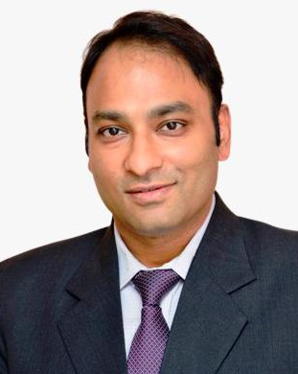
Qualifications & Experience
Prof. (Dr.) Sonu Goel obtained his MBBS and MD in Community Medicine from Indira Gandhi Medical College and Hospital and earned his Ph.D. from Maastricht University. He currently serves as Professor of Health Management at Post Graduate Institute of Medical Education and Research and has over 25 years of extensive experience in public health, health systems strengthening, health management, and tobacco control. He is also Adjunct Professor at the University of Limerick and has served as Honorary Professor at Swansea University.
Research Projects & Publications
Prof. Goel has successfully led and supervised more than 50 national and international research projects as Principal Investigator and Co-Investigator and is currently leading multiple ongoing projects in tobacco control, health systems, and implementation research. He has authored over 290 peer-reviewed scientific publications in reputed national and international journals and has contributed significantly to evidence generation in public health and tobacco control. His scholarly contributions also include edited books, policy documents, technical reports, and patents.
Awards & Achievements
Prof. Goel is a recipient of several prestigious national and international awards and fellowships, including the Dr. R.V. Rajam Recognition of Academic Excellence (RAE), Fellowship of the National Academy of Medical Sciences (FNAMS), Global Research Network Award by the Society for Research on Nicotine & Tobacco (SRNT), Dr. J.E. Park Oration Award, Harcharan Singh Oration Award, Vasudeva Oration Award, and Young Researcher Award by the IAPSM–FORD Foundation. He was also conferred with the Excellence in Public Health Award by the Hon’ble Union Minister of Health & Family Welfare, Government of India.
Work Related to Tobacco Control
Prof. Goel is a globally recognized leader in tobacco control and implementation science. He serves as the Chair of the Tobacco Control Section and leads the MPOWER Research Group of The Union. He is the Director and President of the Resource Centre for Tobacco Control (RCTC) and leads the WHO Collaborative Centre for Research and Training in Tobacco Control. He also serves as the Convenor of the Scientific Support Group for strengthening National Tobacco Testing Laboratories (NTTLs), constituted by the Ministry of Health & Family Welfare, Government of India, and leads multiple initiatives focused on strengthening WHO FCTC implementation, research capacity building, and tobacco product regulation in India and globally.
Prof. (Dr.) Sonu Goel
Professor, DCM & SPH PGIMER Chandigarh
Director & President, Resource Centre for Tobacco Control (RCTC)
Lead, WHO Collaborative Centre for Research & Training in Tobacco Control
Convenor, Scientific Support Group, MoHFW, GOI
Program Director, International Public Health Management Development Program (IPHMDP)
Adjunct Professor, University of Limerick, Ireland
Former Honorary Professor, Swansea University

